Slide 1
Computer Vision

Slide 2
Computer Vision
Computer Vision is the field which deals with the recognition of objects and their inter-relations within an image. It can also be referred to as image understanding or image analysis
A few levels of complexity are included within computer vision:
  recognition of a shape in an image as one of a known set of shapes, e.g., text recognition
  analysis of the characteristics of an object in an image based on its features (shape, color, etc.) as in computer analysis of medical images
  understanding of the entire image, with its objects and their inter-relations, as in automatic navigation of vehicles

Slide 3
Computer Vision
The first task, that of object recognition can be further categorized into
  Verification
  Detection
  Identification
Verification refers to assessing that the object in the image segment is of a certain kind.
Detection refers to finding a category in the picture, e.g. text, faces, cars, people etc.
Identification refers to confirming the presence of a particular instance in the picture, e.g. a face of a certain person, a famous building/statue, a particular brand of a car etc.

Slide 4
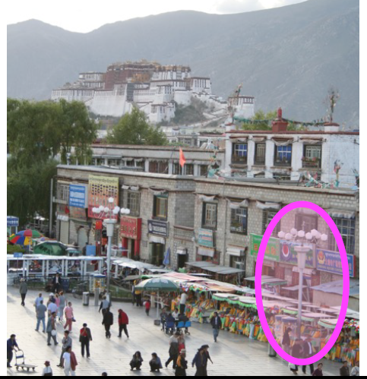
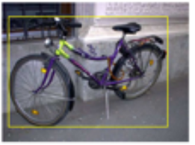
Computer Vision
Verification
Is it a lamp ?
Is it a bicycle ?

Slide 5
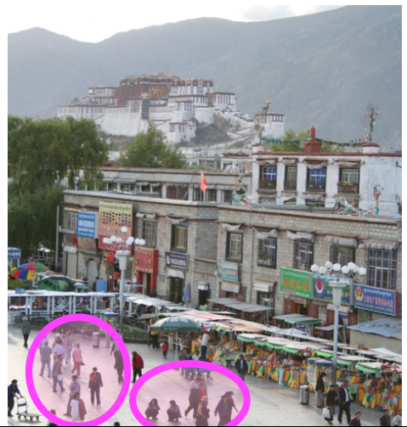
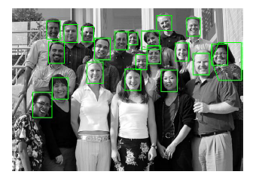
Computer Vision
Detection
Find faces in the picture
Are there people in the scene

Slide 6
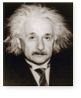
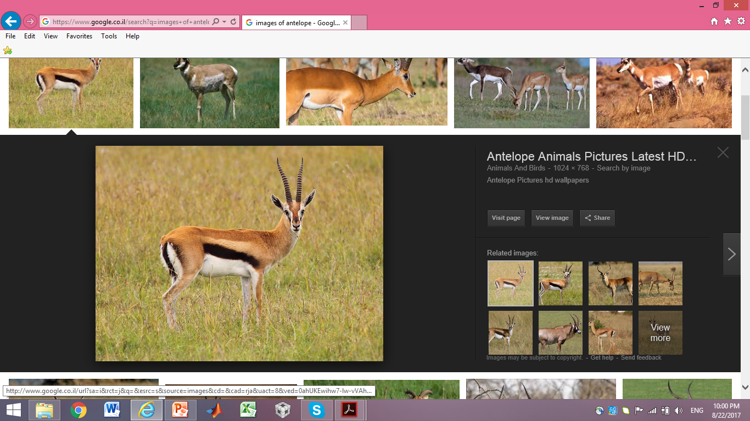
Computer Vision
Identification
Is he Einstein ?
Is it an Antelope ?

Slide 7
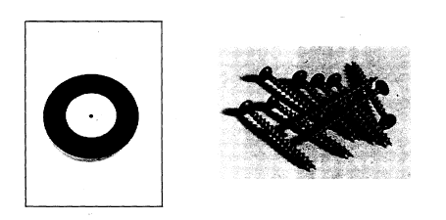
Computer Vision
Even the simplest task, that of shape recognition, can be complicated if
  the shape is complex and looks different from different points of views
  the shape can have a few formats, e.g. the different fonts of a letter ‘a’, different kinds of cars
  some of the shapes to be recognized are similar to each other
  disturbances are possible, like non-uniform lighting, noise and shading

Slide 8
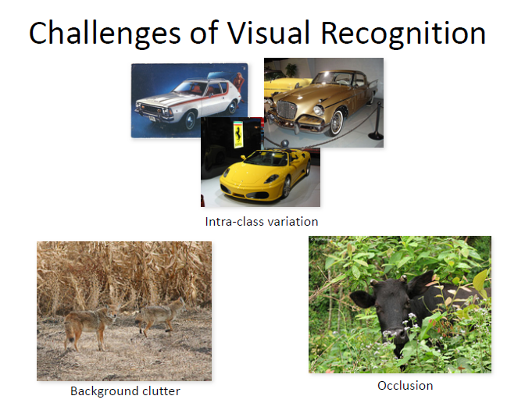
Challenges of Visual Recognition

Slide 9
Selected Applications
Computer vision has many and diverse applications:
  automatic control of industrial production processes
  robot and vehicle navigation
  medical diagnosis
  handwriting and notes recognition (OCR)
  biometric identification: finger-print and facial recognition
  identifying cells in microbiology
  tracking targets, e.g., in military applications
  and many others

Slide 10
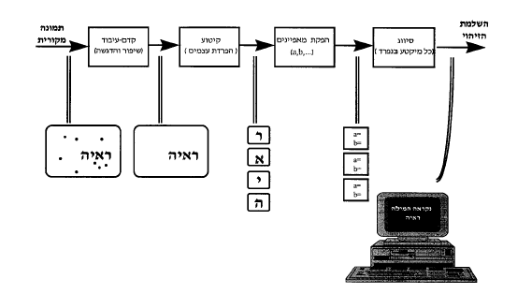
A Computer Vision System
A computer vision system can be thought of as having four stages, which operate in succession:
  image pre-processing to correct impairments
  segmentation to isolate the objects
  feature extraction for an efficient representation of shapes
  classification
Learning
original
image
recognition
completed
preprocessing
segmentation
Features
extraction
classification

Slide 11
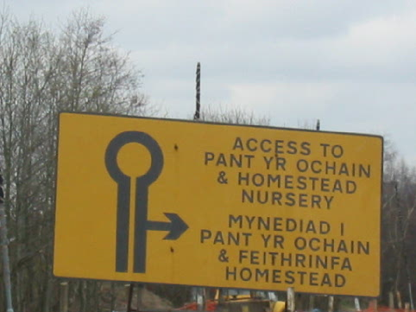
Stages to Read the Road Sign
Extract
Rotate
Segment
Classify

Slide 12
Image Preprocessing
In the preprocessing stage the image is enhanced, and impairments removed, in preparation for next stages:
  disturbances, like noise and shading, are removed
  contrast is enhanced
  geometrical distortions are corrected
  edges are extracted as an initial representation of shapes

Slide 13
Segmentation
In the segmentation stage the different shapes in the image are isolated, so that each can be separately recognized, e.g., a word is not recognized as a single entity, but each of its letters are recognized independently
Similar points (mostly in brightness/color) in the image - belonging to the same object or shape - are grouped together

Slide 14
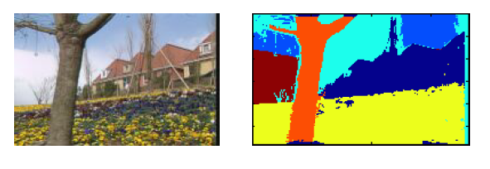
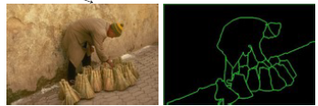
Segmentation
Region Segmentation
Segmentation by Edges

Slide 15
Features Extraction
Shapes and objects in an image are rarely represented by the set of points constituting them. This is because the set of points seldom remains the same due to changes caused by varying lighting conditions, camera position changes and others.
A more robust way for representing shapes is required - representation by features.
A feature is an evident characteristic of a shape, e.g., its color, its area, its circularity etc.

Slide 16
Classification
The last stage in the computer vision process is the classification - the decision which object is found in the image
Most commonly, the assumption is that the shape in the image is one of a known set of shapes - the reference shapes. For example, in text recognition, it is assumed that the shape under consideration is one of the alphabet characters
Classification is performed based on some selected measure of similarity between the set of features of the unknown shape and those of the reference shapes.
The features of the reference shapes are extracted in the learning stage

Slide 17
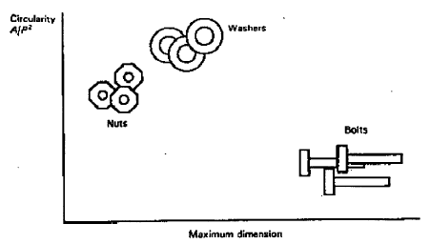
An Example
It is required to identify bolts, nuts and washers moving on a production line
Possible features, which are useful to distinguish between the 3 shapes, are length and circularity (the resemblance to a circle). Circularity is measured by the ratio of area and square of perimeter, which equals 1 for a circle.
The distribution of features for given samples of the 3 shape is :

Slide 18
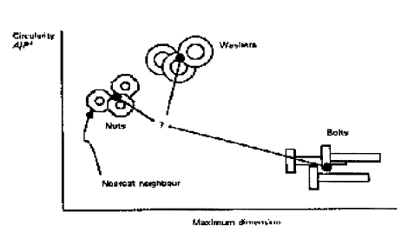
An Example - Cont.
An object, whose features are as in the point marked by ‘?’, is classified as a nut, if a measure of minimal distance is used for classification - the center of the nuts group is closest to the point ‘?’ of the unknown object

